Slide 1

Loops

Slide 2
Repeat
DataTypes
Naming Conventions

Slide 3

Loop
A loop is a sequence of instruction s that is continually repeated until a certain condition is reached
While
Do-While
ForEach
For
Infinite Loops

Slide 4
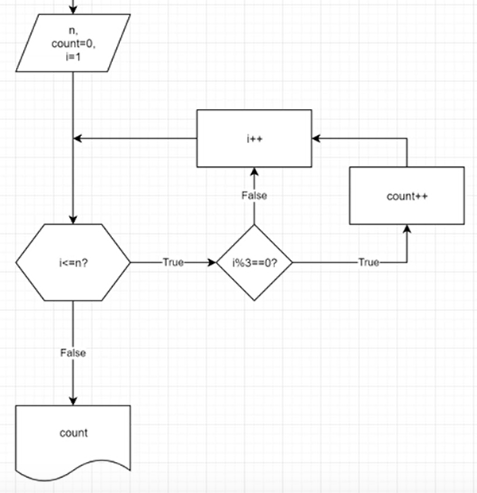
Example 1 - With FlowChart
Notes:
I+3 instead of i++

Slide 5
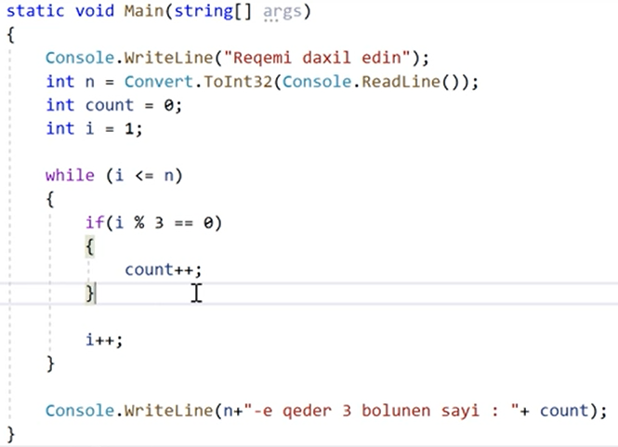
Example - With C#

Slide 6
Example - Your Turn
Verilen 2 eded arasinda hem 3-e hem de 4-e bolunen ededlerin sayi
Inclusive Interval Anlayishi

Slide 7
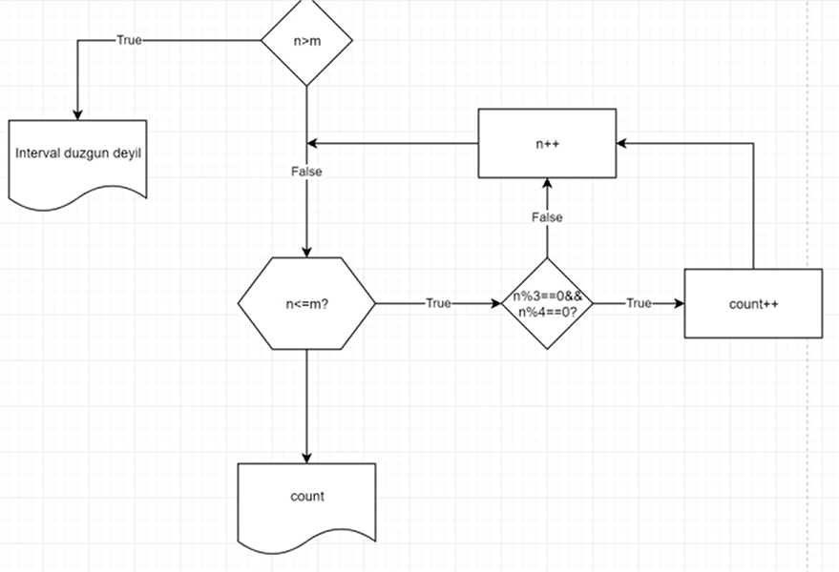
Answer

Slide 8
Thanks!
Lab Tomorrow

